Slide 1

Fion Bank Business Case
Data Management & Business Intelligence Assignment 2
14/12/2021
Vaniotis John – f2822101
Ninas Konstantinos – f2822108
Notes:
Στα πλαίσια της 2^{ης} εργασίας του μαθήματος Data Management & Business Intelligence έχουμε ετοιμάσει το παρών Business Case που θα θέλαμε να σας παρουσιάσουμε.

Slide 2

Banking Business Case – Fion Bank
More than 880.000 loans provided in Ireland
Loans granted from (2007-2015)
Loans granted for a variety of purposes
Primary goal: evaluate the criteria used to determine the borrower’s financial risk
Secondary goals
Create a better understanding in the relationship between installments, loan amounts lent and the borrower’s characteristics
Identify the connection between loan amounts lent, loan purpose and borrower’s characteristics
Notes:
Το Business Case μας αφορά την Ιρλανδική τράπεζα Fion Bank. Η Fion Bank έχει χορηγήσει πάνω από 880.000 δάνεια σε βάθος 9 ετών (από το 2007-2015) για μια πληθώρα διαφορετικών λόγων, όπως είναι τα στεγαστικά, επιχειρηματικά δάνεια και τα δάνεια εκπαιδευτικής φύσεως. Μάλιστα, έχουμε θέσει ορισμένους στόχους που θα προσπαθήσουμε να εξερευνήσουμε παρακάτω. Βασικός στόχος είναι η αξιολόγηση των κριτηρίων που χρησιμοποιεί η Fion Bank για την αναγνώριση του χρηματοπιστωτικού κινδύνου των δανειοληπτών της.

Slide 3




Dataset Selection
Data sources
Kaggle
KDNuggets
GitHub
Google Dataset Search
Selection criteria
>100k observations
At least 20 variables
At least 5 measures
Interesting business case development
https://www.kaggle.com/mrferozi/loan-data-for-dummy-bank
Notes:
Προτού όμως σας μιλήσουμε για το Business Case θα θέλαμε να σας πούμε λίγα λόγια για την διαδικασία εύρεσης του τελικού μας Dataset. Αρχικά, πλοηγηθήκαμε σε πολλές διαφορετικέ ιστοσελίδες (όπως το Kaggle και το GitHub) και χρησιμοποιήσαμε σε μεγάλο βαθμό το Google Dataset Search. Το οποίο είναι μια μηχανή αναζήτησης που παρέχεται δωρεάν από την google και χρησιμοποιείται αποκλειστικά για λόγους εύρεσης dataset. Επίσης, θέσαμε ορισμένα κριτήρια για την επιλογή του dataset μας, όπως το μέγεθος του, και ο αριθμός των μεταβλητών του. Συγκεκριμένα, θέλαμε ένα dataset που να διαθέτει τουλάχιστον 100Κ παρατηρήσεις και 20 μεταβλητές. Ταυτόχρονα θέλαμε να υπάρχει μια ισορροπία μεταξύ των μετρικών και των διαστάσεων ανάμεσα στις μεταβλητές αυτές. Τέλος, σημαντικότερος παράγοντας επιλογής ήταν η προοπτική ανάπτυξης ενός ενδιαφέροντος business case μέσα από το dataset.

Slide 4
Data Cleaning
Number of dataset’s variables 30 -> 25
13 redundant variables removed
8 new variables were added using existing data
All variables were examined for missing values and outliers
Mismatched data types were fixed
Saved in csv formatted file

Slide 5
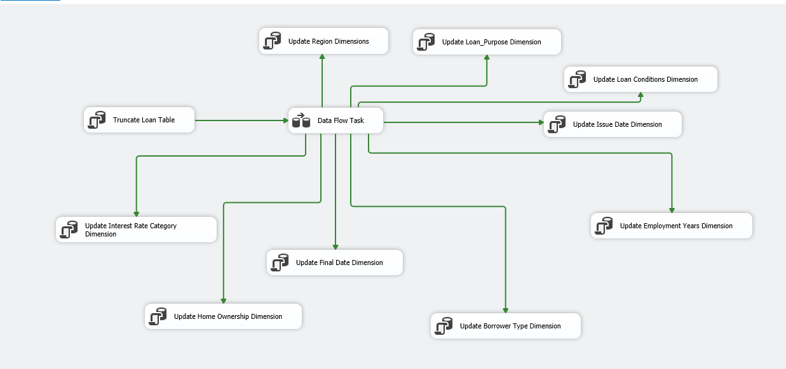
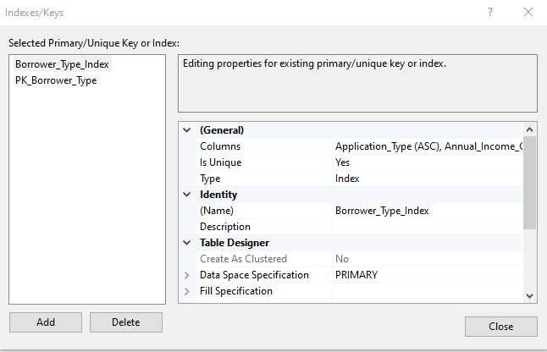
Data Loading
Platforms:
Database in SSMS
Integration Services project in SSDT
To load the data, we used:
Flat File Connection Manager (SSDT)
SQL Destination Editor
SQL Tasks (Truncate, Dimensions, Fact Table)
Creation of Dimension Tables
Total of 9 (e.g. Region, Loan Purpose)
Primary keys
Index Constraints

Slide 6
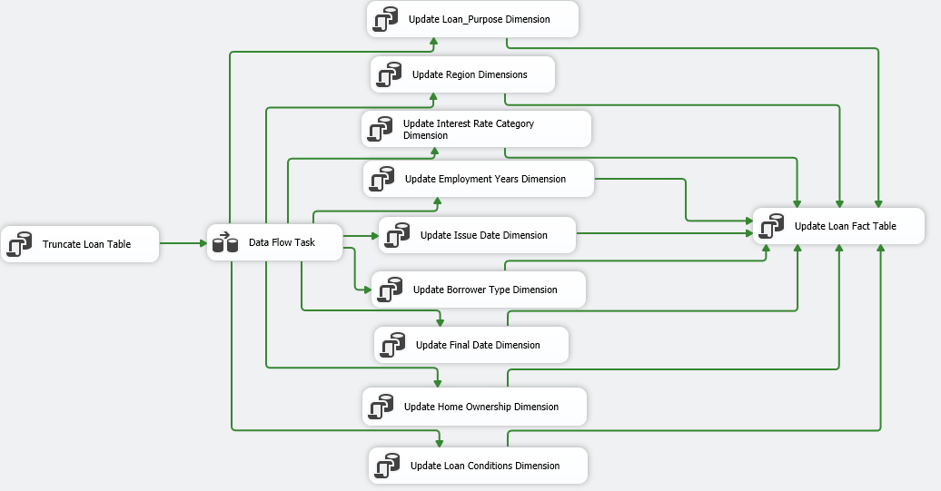
Data Loading
Fact Table contains:
All the measures of the initial dataset
Foreign keys that connect him with the Dimension Tables
To automate the update process, we created:
Process shortcut in SSMS
Daily Schedule

Slide 7
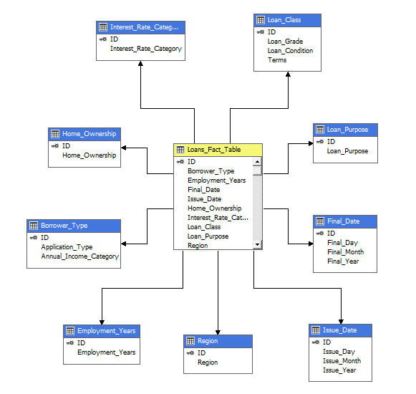
Multidimensional Model (Cube)
Created in ‘Analysis Services Multidimensional and Data Mining’ project in SSDT
Star-Schema from Fact Table and Dimension Tables
Difficulties encountered:
Previous steps were completed using a Microsoft Account
Existing calculations not sufficient
Process Cube shortcut in Integration Services Project

Slide 8
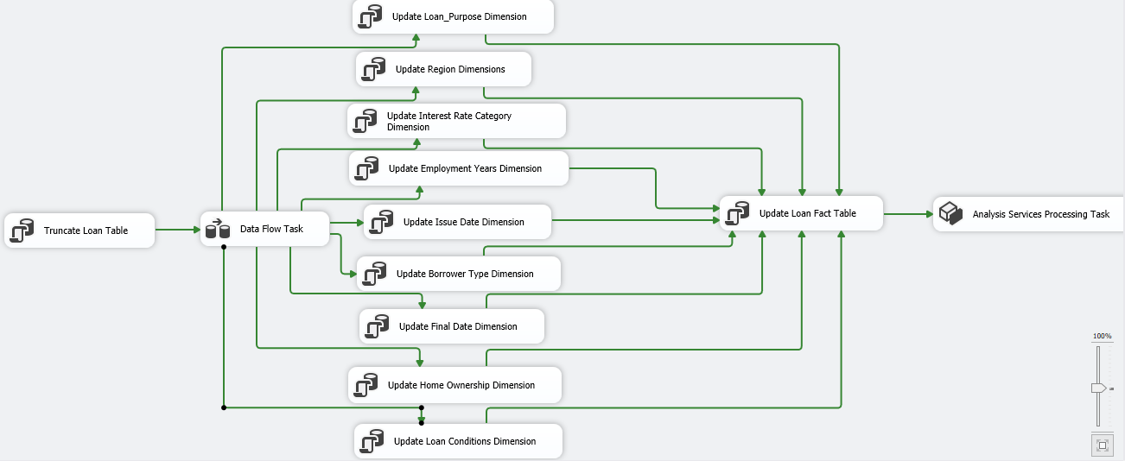

Integration Services Final Flow

Slide 9
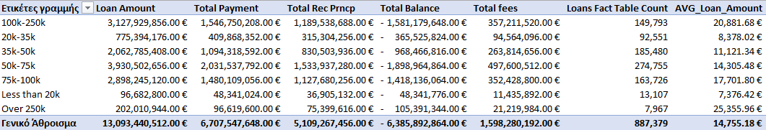
Excel Reporting
Cube can be exported to Excel from SSDT
Loan and Payment Amounts per Income Category Report
The greatest % of borrowers have an income of 50-75K €
Average loan amount tends to rise for borrowers with greater income

Slide 10
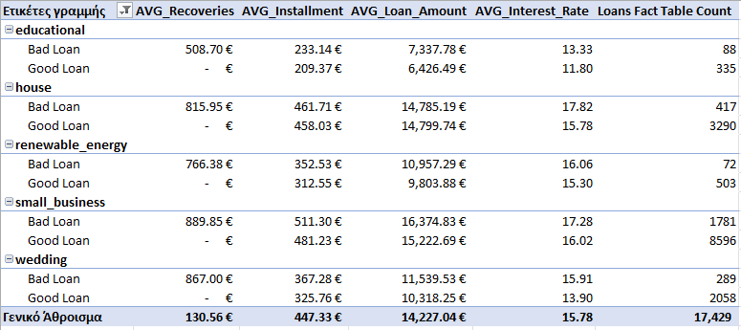
Excel Reporting
Top 5 loans purposes for granting a loan in terms of average recoveries
Loans that default have
Higher interest rates
Higher loan amounts
Higher monthly payments
Borrowers that default comprise at most 20% of total borrowers for these categories

Slide 11
Data Visualization – Fion Bank Summary
Usage of Power BI
Fion Bank’s Descriptive Insights
Total loans granted - 13 billion €
Total payments received – 6.7 billion €
Total fees earned – 1.6 billion €
The last 3 years recorded cover almost 90% of total loans granted
Difference in fees collected is proportionally small compared to the difference in loan amounts between borrowers with incomes 50-75K € & 100-250K €

Slide 12
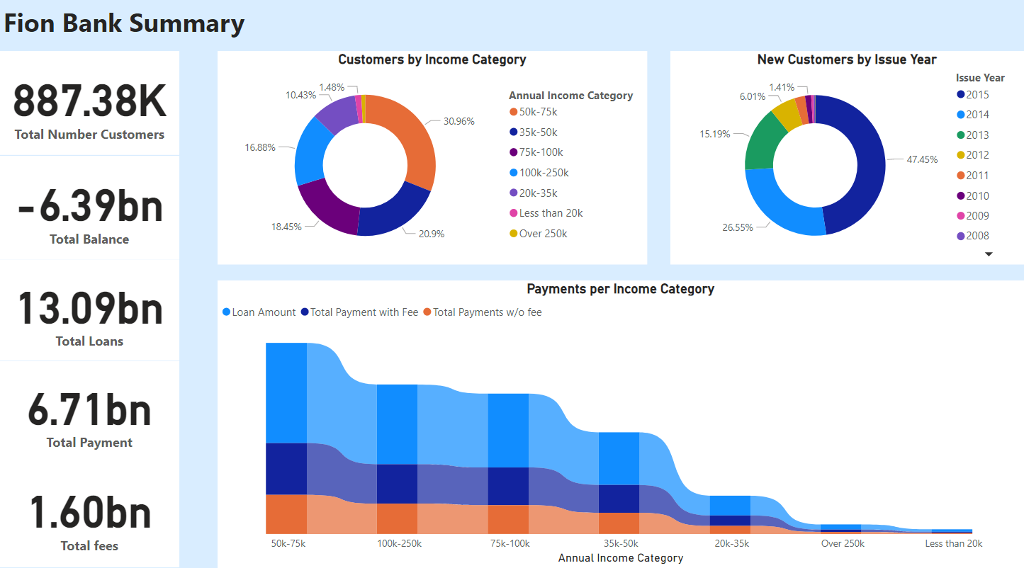

Slide 13
Data Visualization – Borrower Profile
Identification of borrowers’ profiles
Almost half of bank’s total borrowers have a mortgage
Only 2% of the borrowers have no residence
In the dti graph, two patterns can be observed:
For loans graded A-D, an upward trend in the borrowers’ average income and a downward trend in the average dti can be observed
For loans graded E-G, the reverse behavior in comparison to A-D can be observed
Highest installments for borrowers that received mortgage or small-business loans
In some cases, borrowers’ average loan amounts are not solely dependent on the customer income

Slide 14
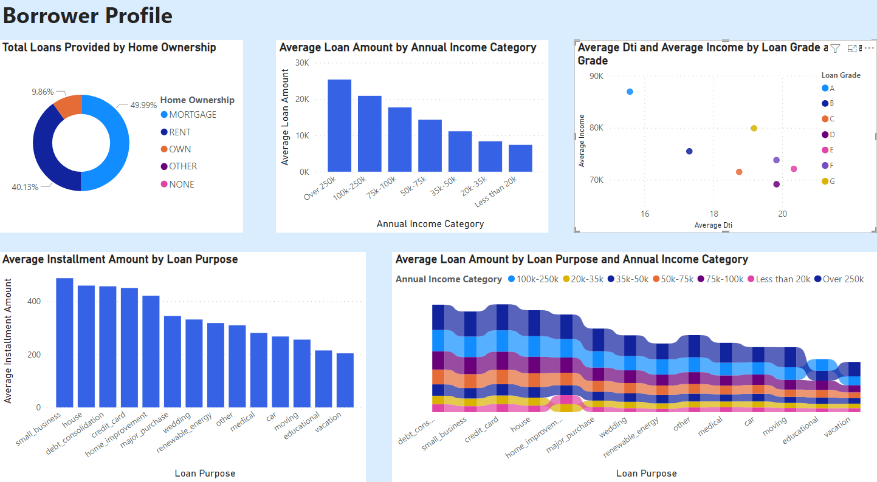

Slide 15
Data Visualization – Customer Risk
The interest rates of loans are inversely proportional to borrowers’ income and the loan grade
Lower average interest rates for borrowers with residence
Loans that get repaid on time (good loans) have lower average interest rates compared to loans that default
Fion Bank considers:
Highest risk loans (mortgage, small business)
Lowest risk loans (car purchase, educational, credit card)

Slide 16
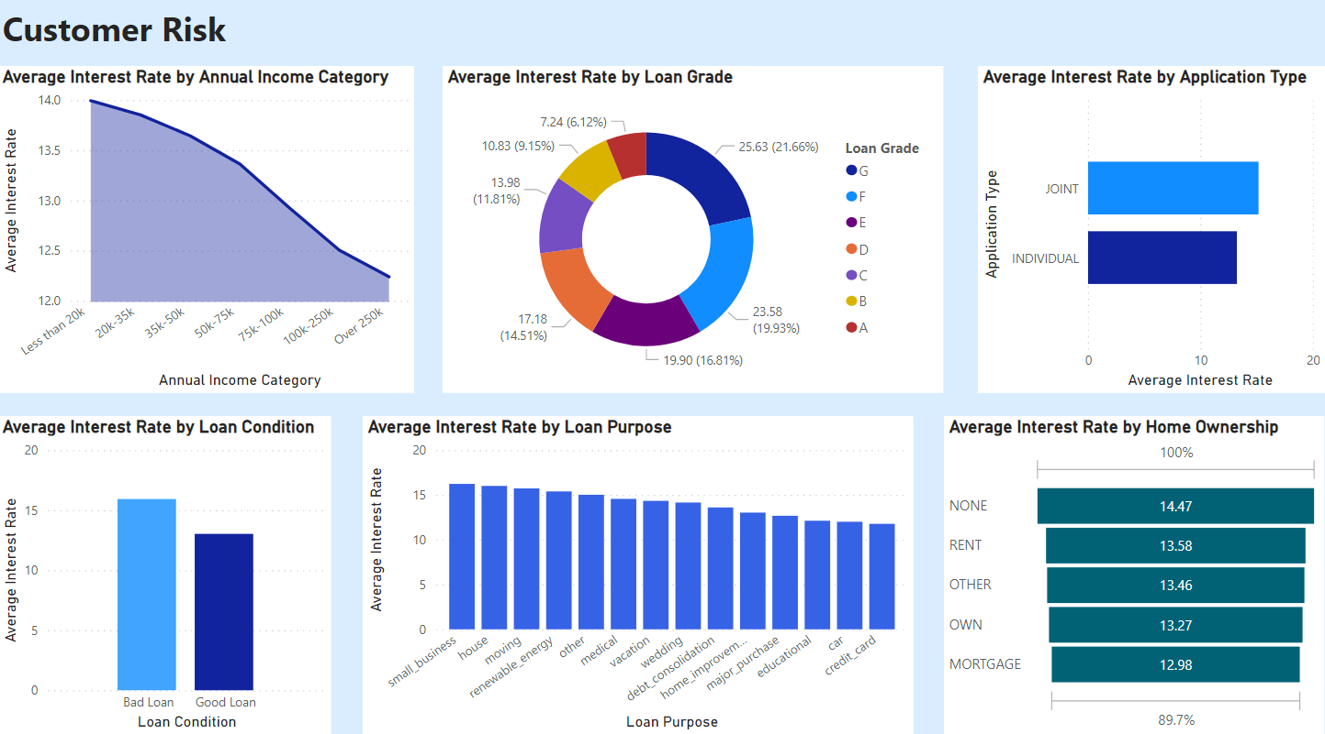

Slide 17
Data Visualization - Recoveries
Borrowers with middle to high incomes (>50K €) have higher average recovery amounts than borrowers with smaller incomes
Loans with high loan amounts usually have high recovery amounts
Educational loans present a special case:
Low average loan amount
High average recoveries
Loans with high credit ratings and low interest rates have lower average recovery amounts
Borrowers who own their residence usually have smaller recoveries

Slide 18
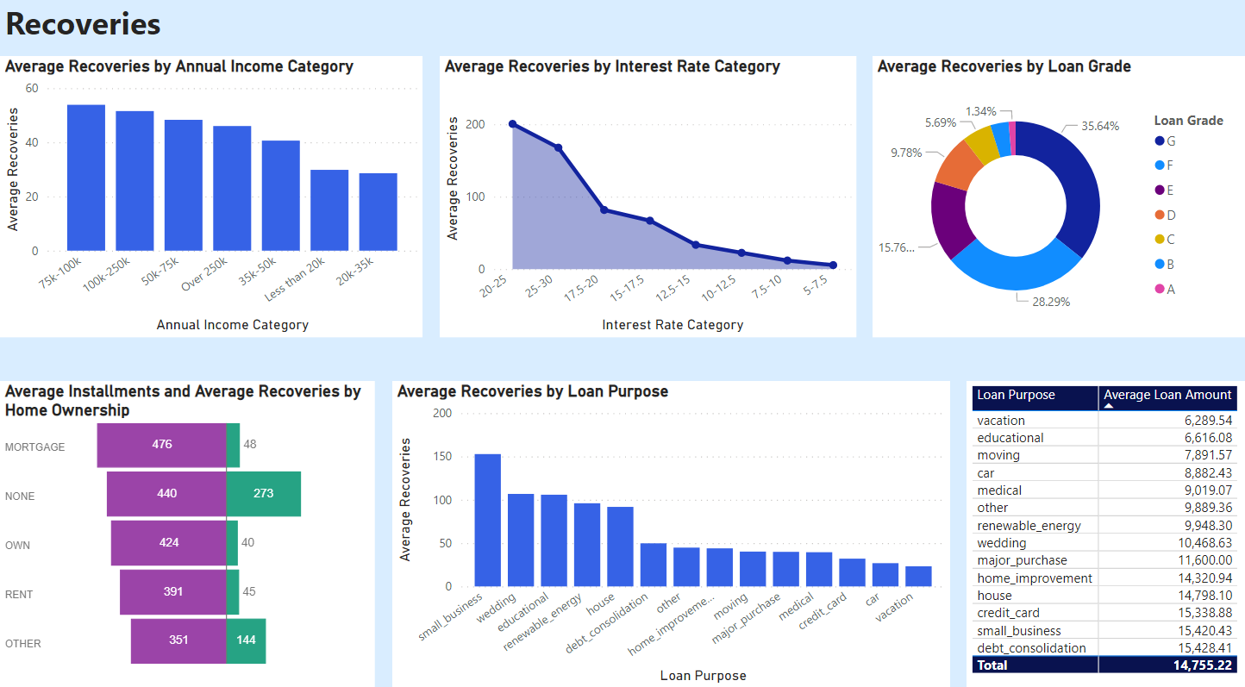

Slide 19
Σας ευχαριστούμε για τον χρόνο σας!

